Slide 1
DATS 6401 Visualization of Complex Data Individual Project
Instructor: Nima Zahadat, Ph.D.
Changhao Ying
03/02/2020

Slide 2
Abstract
This project is about analysis of Top 10 countries’ (United Kingdom, Brazil, Germany, France, Italy, Mexico, Argentina, Switzerland, Australia, Indonesia) education, healthcare and military expenditure compared to theirs GDP in the period of 2011-2015.
The data is from worldbank and I used pycharm to preprocessed the data.
I built website through visual studio code and used Google API to visualize the data in easy and different ways.

Slide 3
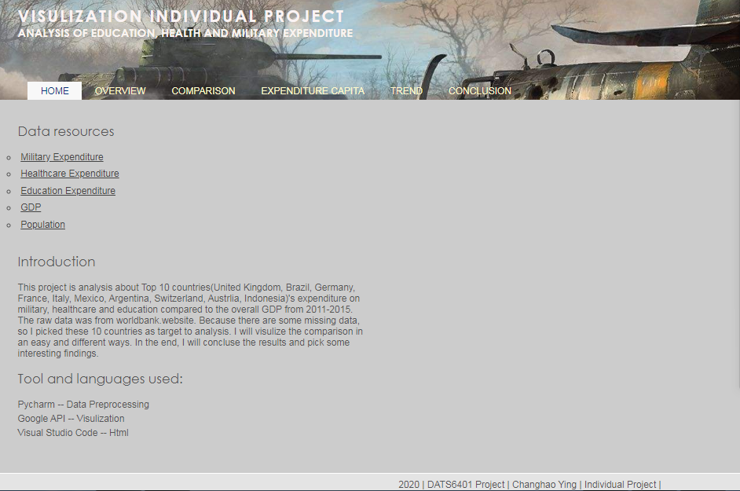
Introduction

Slide 4
Introduction
This is the index website of my project. Visitors can access the raw data source website to check the data.
The overview section compares the 10 countries’ spending to their GDP in histogram.
The comparison section compares the educational and healthcare expenditure to military spending in bar chart.
The expenditure capita section shows the 5 years’ mean spending in bubble chart.
The trend section shows the countries’ expenditure and GDP growth in line chart.
The conclusion section contains my findings of the analysis.

Slide 5
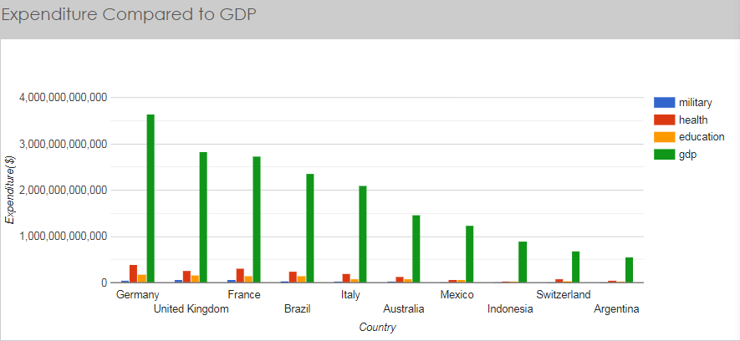
Overview
Here we can see the 10 countries’ mean expenditure and GDP over 5 years.

Slide 6
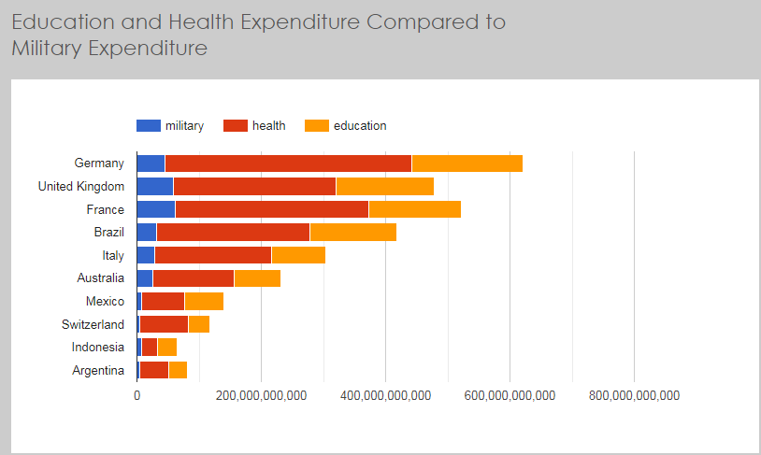
Comparison
Here is the comparison between the 3 spending.

Slide 7
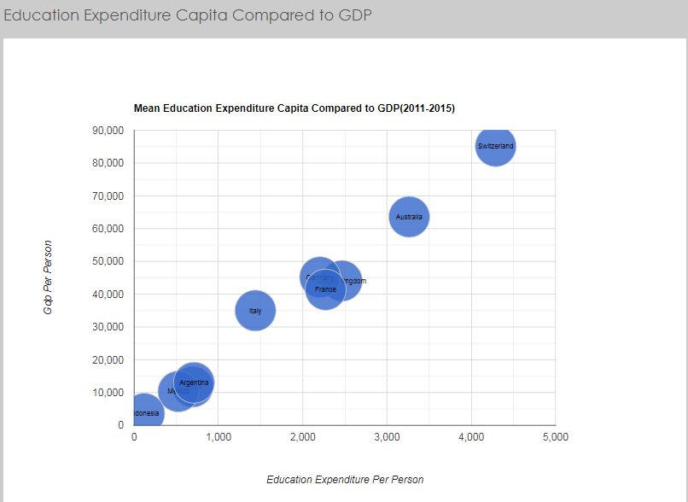
Capita Expenditure
Educational expenditure per person to GDP

Slide 8
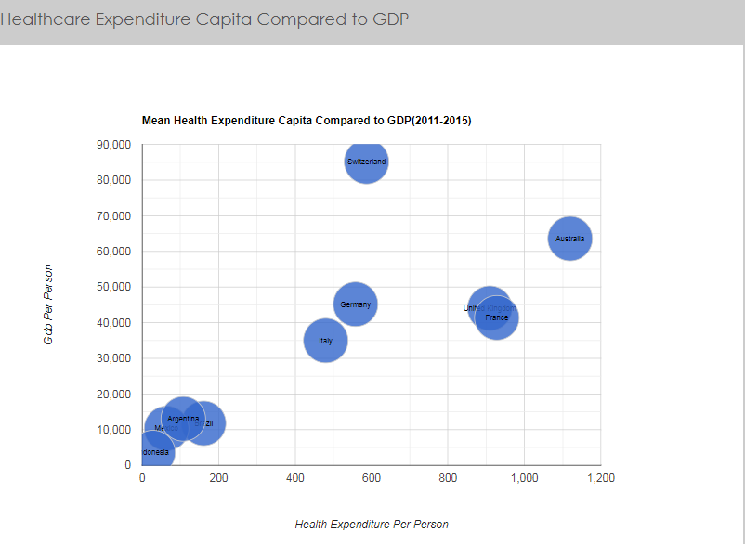
Capita Expenditure
Healthcare expenditure per person to GDP

Slide 9

Capita Expenditure
Military expenditure per person to GDP

Slide 10
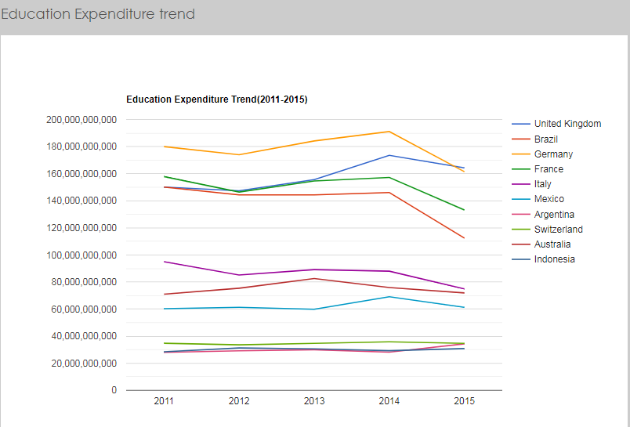
Trend
The education expenditure trend over 5 years.

Slide 11

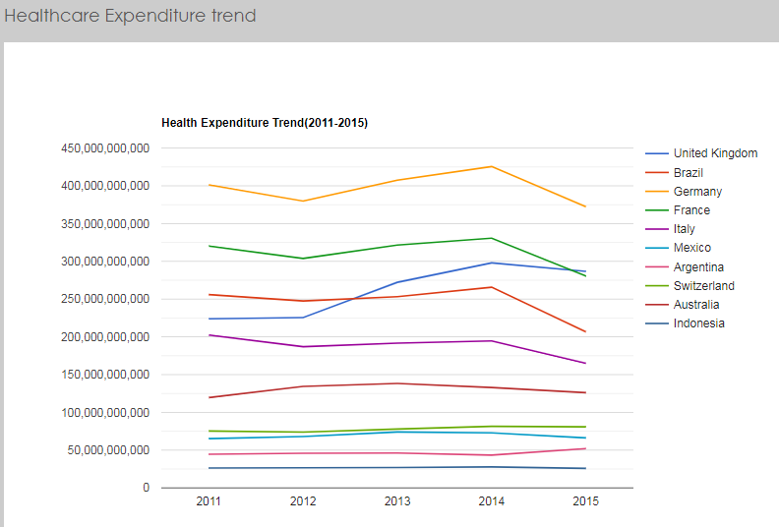
The healthcare expenditure trend over 5 years.

Slide 12


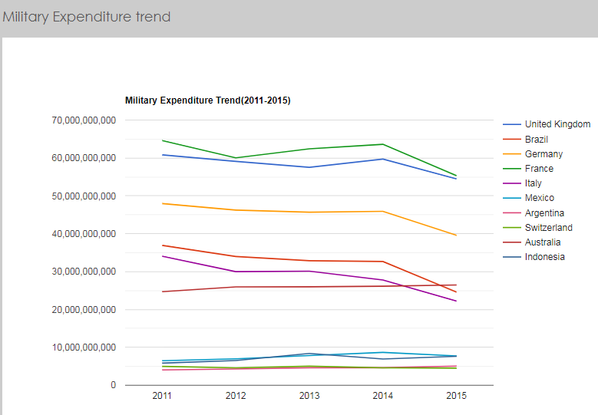

Slide 13
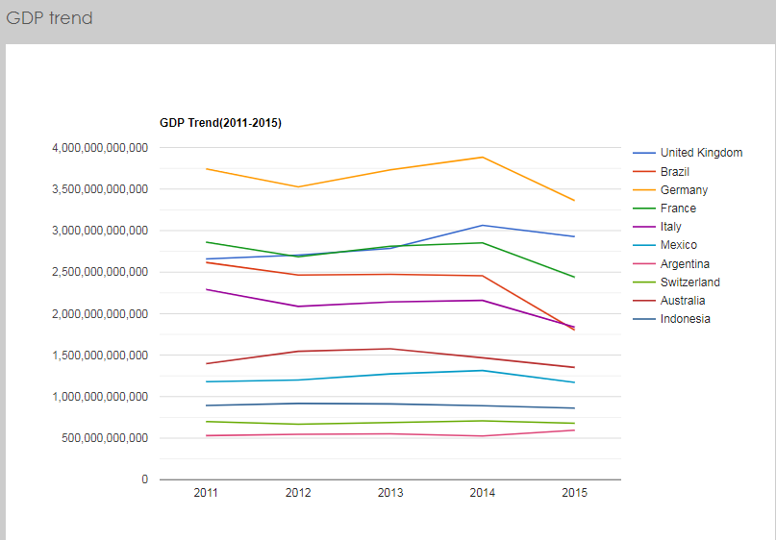
Trend
GDP over 5 years

Slide 14
Conclusion
Germany has highest GDP and performs best with highest expenditure on healthcare and education.
France and United Kingdom have highest expenditure on military.
In the period of 2014-2015, GDP and all expenditure became lower which means the whole economy circumstance was bad.

